Slide 1
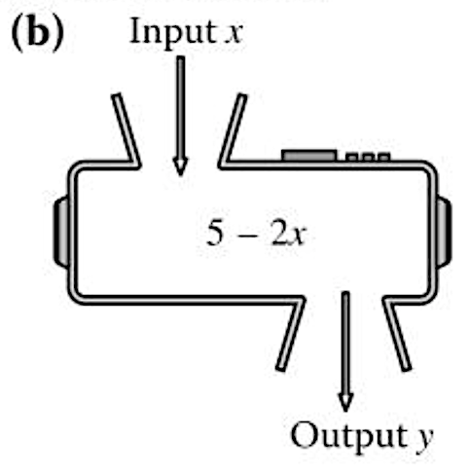






Assessment
MY SCORE
Q1 | Q2 | Q3 | Q4 | Q5 | Q6 | Q7 | Q8 | Q9 | Q10 | Q11 | Q12 | Q13 | Q14 | Total
/2 | /2 | /2 | /2 | /2 | /5 | /3 | /2 | /6 | /7 | /3 | /3 | /2 | /4 | /45
Q1 – Prior Knowledge
Q2 – Prior Knowledge
Calculate $\frac{5}{7}+\frac{3}{5}$
Factorise $x^{2}+5x+6$
Q3 – Prior Knowledge
Q4 – Prior Knowledge
Q5 – Prior Knowledge
Simplify $\frac{3(x+1)}{\left(x+1\right)}$
Make $x$ the subject.
$$5x+2=y$$
Here is a function machine
What is the output if the
input is 4?
Q6 – Simplify the algebraic fractions
a) Simplify fully $\frac{4x+12}{x+3}$
b) Simplify fully $\frac{x^{2}+7x+12}{2x+8}$

Slide 2
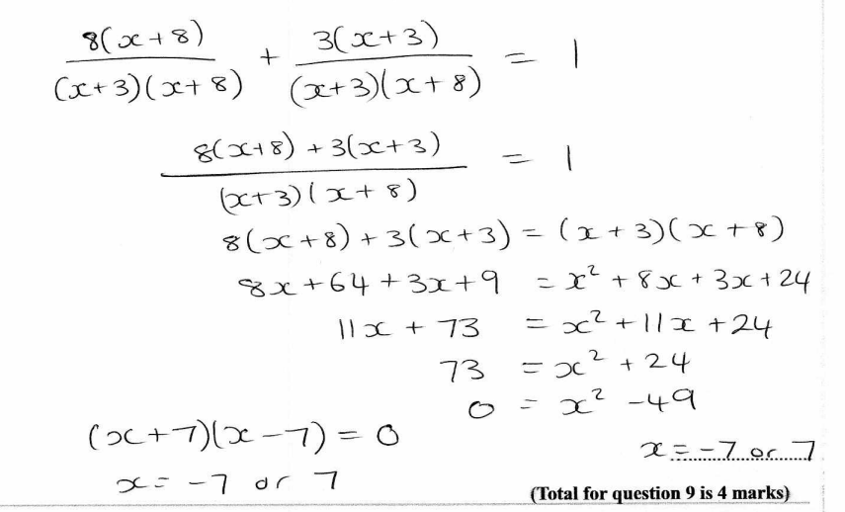
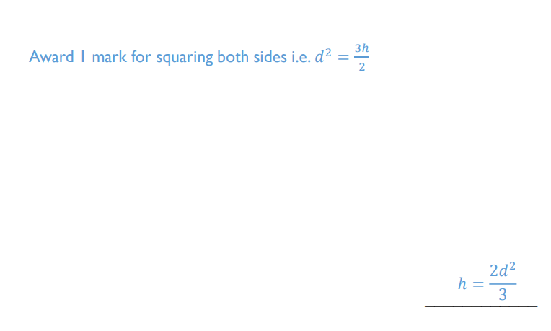
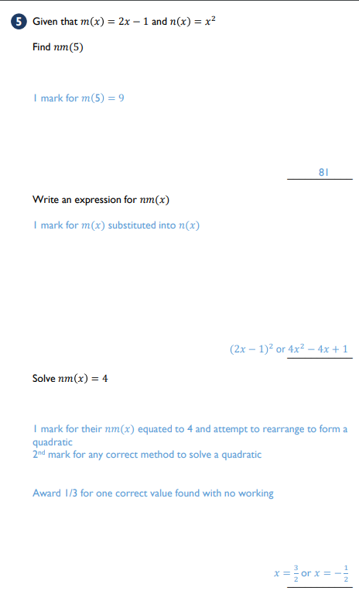
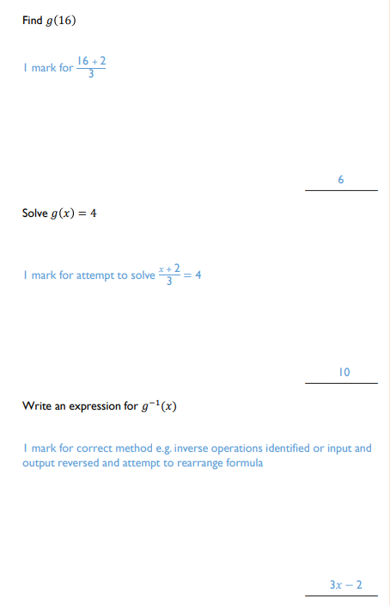

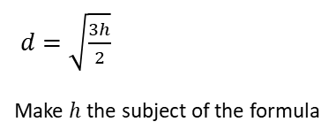


Q7 – Algebraic Fractions
Q8 – Changing the subject
Solve $\frac{8}{x+3}+\frac{3}{x+8}=1$
$d=\sqrt{\frac{3h}{2}}$
Make $h$ the subject of the formula
Q9 – Functions
Q10 – Functions
Given that $g\left(x\right)=\frac{x+2}{3}$
Find $g\left(16\right)$
Solve $g\left(x\right)=4$
Write an expression for $g^{−1}(x)$
Given that $m\left(x\right)=2x−1$ and $n\left(x\right)=x^{2}$
Find $nm\left(5\right)$
Write an expression for $nm\left(x\right)$
Solve $nm\left(x\right)=4$

Slide 3
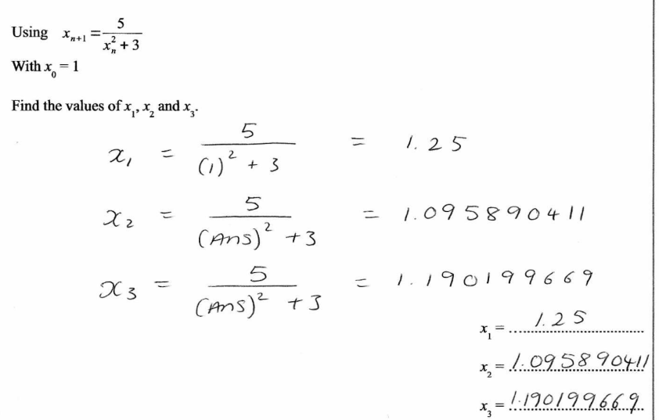
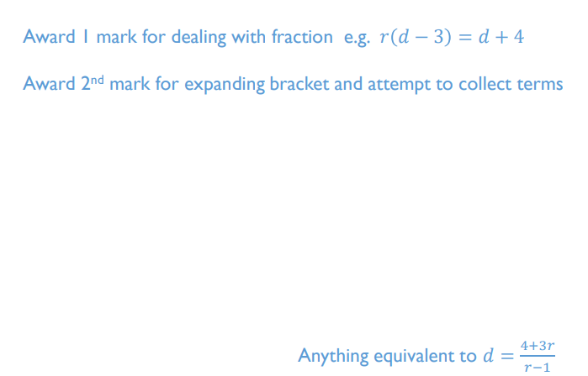
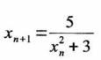
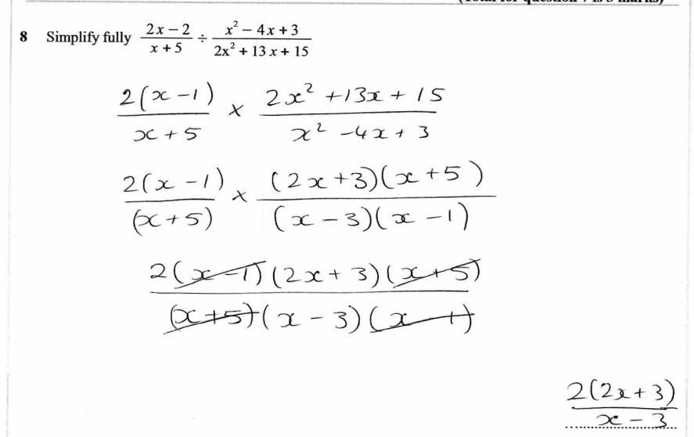
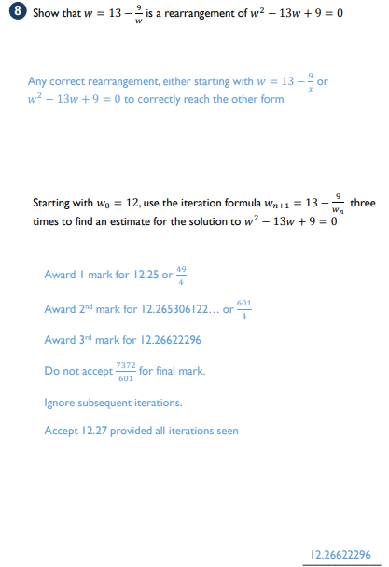

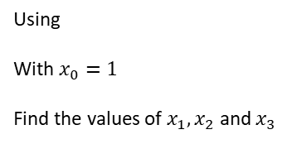

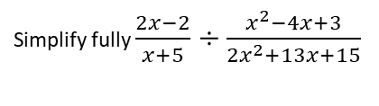


Q11 – Iteration
Q12 – Changing the subject Changing the subject where the subject appears twice
Using
With $x_{0}=1$
Find the values of $x_{1},x_{2}$ and $x_{3}$
Make $d$ the subject of the formula $r=\frac{d+4}{d−3}$
$$x_{1}=$$
$$x_{2}=$$
$$x_{3}=$$
Q13 – Proof
Q14 – Challenge
Prove the sum of four consecutive odd numbers is always a multiple of 8
Simplify fully $\frac{2x−2}{x+5}÷\frac{x^{2}−4x+3}{2x^{2}+13x+15}$

Slide 4
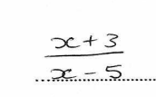






Feedback Assessment
MY SCORE
Q1 | Q2 | Q3 | Q4 | Q5 | Q6 | Q7 | Q8 | Q9 | Q10 | Q11 | Q12 | Q13 | Q14 | Total
/2 | /2 | /2 | /2 | /2 | /5 | /3 | /2 | /6 | /7 | /3 | /3 | /2 | /4 | /45
Q1 – Prior Knowledge
Q2 – Prior Knowledge
Calculate $\frac{3}{4}+\frac{2}{7}$
Factorise $x^{2}+x−6$
Q3 – Prior Knowledge
Q4 – Prior Knowledge
Q5 – Prior Knowledge
Simplify $\frac{x(x−2)}{4\left(x−2\right)}$
Make $x$ the subject.
$$7x−c=y$$
Here is a function machine
What is the output if the
input is 7?
Q6 – Simplify the algebraic fractions
a) Simplify fully $\frac{5x − 15}{x−3}$
b) Simplify fully $\frac{x^{2}−x−12}{x^{2}−9x+20}$

Slide 5

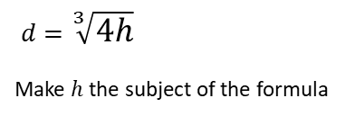


Q7 – Algebraic Fractions
Q8 – Changing the subject
Solve $\frac{2}{x−3}+\frac{1}{x−4}=2$
$d=\sqrt[3]{4h}$
Make $h$ the subject of the formula
Q9 – Functions
Q10 – Functions
Given that $g\left(x\right)=4x+3$
Find $g\left(−3\right)$
Solve $g\left(x\right)=19$
Write an expression for $g^{−1}(x)$
Given that $m\left(x\right)=3x+2$ and $n\left(x\right)=\frac{1}{x}$
Find $nm\left(2\right)$
Write an expression for $nm\left(x\right)$
Solve $nm\left(x\right)=2$

Slide 6


Q11 – Iteration
Q12 – Changing the subject where the subject appears twice
The number of rabbits in a field $t$ days from now is $P_{t}$ where
$$P_{0}=220$$
$$P_{t+1}=1.15(P_{t}−20)$$
Work out the number of rabbits in the garden 3 days from now
Make $c$ the subject
$$w=\frac{ac}{a−c}$$
Q13 – Proof
I think of two consecutive integers. Prove that the difference of the squares of these integers is equal to the sum of the two integers.

Slide 7
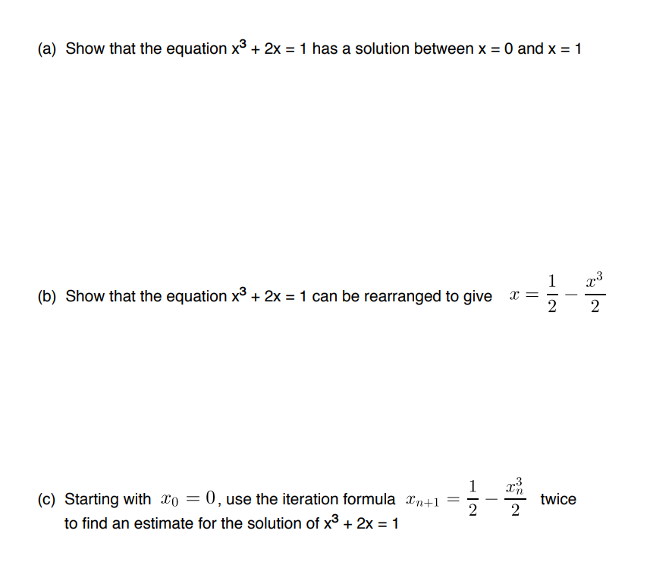
Q14 – Challenge

